Slide 1

SWEN 755: Software Architecture
Viktoria Koscinski
Recommended reading:
Chapter 13 in SAIP 3rd edition
Two complementary patterns to build multi-expert systems
http://www.thomasalspaugh.org/pub/fnd/architecture.html
Notes:
SAIP = Software Architecture in Practice
Two Complementary Patterns = https://hillside.net/plop/plop97/Proceedings/lalanda.pdf

Slide 2
Plan
Topics for this week
Pattern recap
Three architectural styles:
Blackboard
MVC: Model-View-Controller
MVVM: Model-View-ViewModel

Slide 3
Patterns
Pattern recap
An architectural pattern:
Is a package of design decisions found repeatedly in practice
Has known properties that permit reuse
Describes a class of architecture
Is discovered, not invented
Therefore, new patterns may emerge over time
Notes:
Most patterns consist of (are constructed from) several different tactics. (p. 204 – textbook)

Slide 4

Patterns
Pattern: Blackboard
Useful for problems for which no deterministic solution strategies are known.
In Blackboard, several specialized subsystems assemble their knowledge to build a possibly partial or approximate solution. (traditional definition)
Notes:
This provides non-functional properties such as reusability, changeability, robustness

Slide 5
Blackboard
When to use Blackboard architecture
A complete search of the solution space is not feasible in a reasonable time. (Ex: phrases of up to ten words using a vocabulary of 1000 words → 1000¹⁰ feasible solutions.
Domain is immature – need to experiment with different algorithms for the same subtask. Individual submodules should be easily exchangeable.
Different algorithms that solve partial problems.
Algorithms work on the results of other algorithms.
Uncertainty and approximation are involved.
Example usage domains: speech recognition, vehicle identification/tracking, protein structure identification
Notes:
Domain is immature – may need to integrate diverse modules

Slide 6

Blackboard
Blackboard Architecture - Solution
Collection of independent programs that work cooperatively on a common data structure.
Each program is specialized for solving a particular part of the overall task, and all programs work together on the solution.
Specialized programs work independently.
Do not call each other.
No predetermined sequence for their activation.

Slide 7
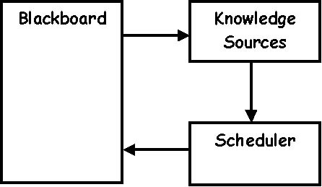
Blackboard
Blackboard Architecture - Solution
Divide the system into a component called a blackboard, a collection of knowledge sources, and a control component.
Blackboard is the central store – containing elements of the solution space and the control data.
Vocabulary is set of all data elements that can appear on the blackboard.
Partial solutions = hypothesis or blackboard entry.
Notes:
Knowledge sources can be seen as specialists in sub-fields of the global application and are only able to solve sub-problems; they read/write relevant data in the blackboard; specialized modules
Blackboard is a structured global memory where the solution to the problem is incrementally constructed; contains hypotheses
Control component/scheduler (in image); uses domain-specific heuristics to rate the relevance of executable knowledge sources; selects, configures, and executes the knowledge sources
https://hillside.net/plop/plop97/Proceedings/lalanda.pdf

Slide 8
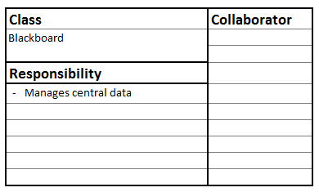
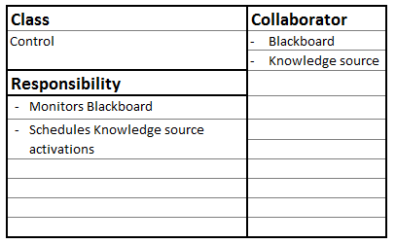
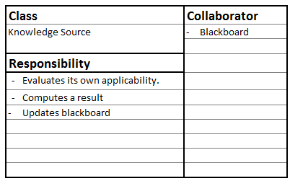
Blackboard
Blackboard Architecture - Solution
Two problems:
Too many hypotheses/alternatives to consider
There might not be an answer
The control component should halt the system if an acceptable hypothesis is found, or when the resources of the system are exhausted
Notes:
There might be too many hypotheses/ alternatives to consider (so we have to limit the choices)
There might not be an answer (so we have to tell the users)
So, the control component should halt the system if an acceptable hypothesis is found, or when the space or time resources of the system are exhausted
http://www.openloop.com/softwareEngineering/patterns/architecturePattern/arch_Blackboard.htm

Slide 9
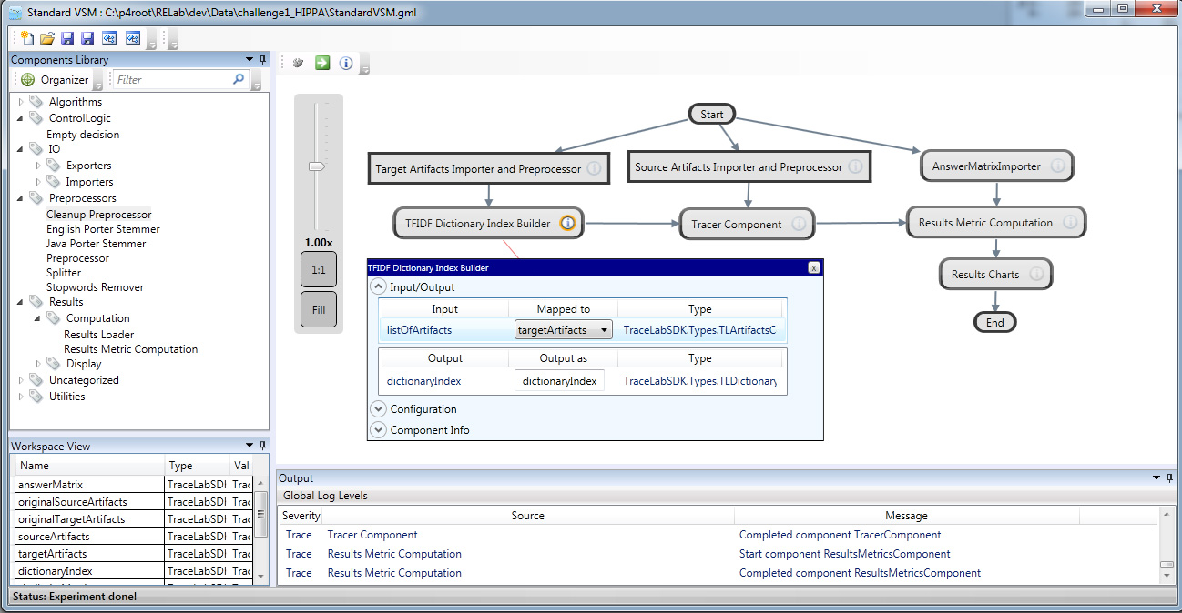
Blackboard
A Relaxed Blackboard Architecture
TraceLab – a tool for supporting traceability research. (Similar systems MatLab, RapidMiner, etc etc.)

Slide 10
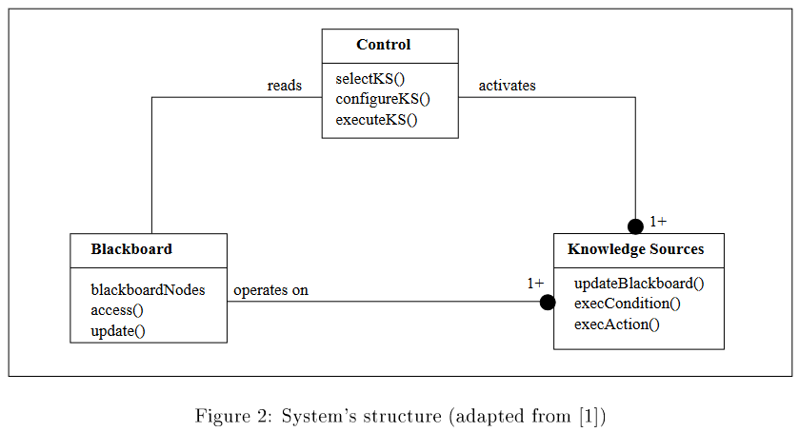
Blackboard
Blackboard Architecture

Slide 11
Patterns
Pattern: MVC
The Model-View-Controller (MVC) architectural pattern divides an interactive application into three components.
Notes:
Different architectural patterns imply different consequences. For example, an MVC architecture is often more efficient than a PAC (presentation-abstraction-control) architecture; while PAC supports multi-tasking and task-specific user interfaces better than MVC does.
In contrast to MVC, PAC is used as a hierarchical structure of agents, each consisting of a triad of presentation, abstraction and control parts.
You may need to design both for complexity of component distribution in a heterogeneous computer network and also for adaptability of their user interfaces.
The BROKER pattern provides the infrastructure for the distribution of components, while the model in the MVC pattern plays the role of a server in the BROKER infrastructure.
Controllers take roles of clients, and views combine the roles of clients and servers, as clients of the model and servers of the controllers.

Slide 12
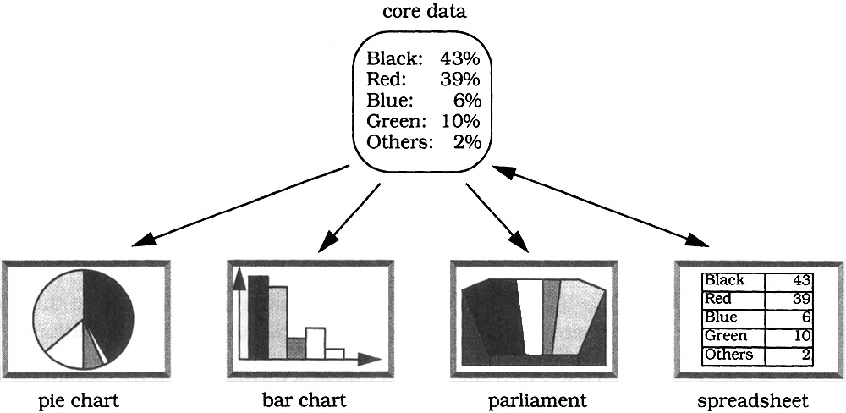
MVC
MVC
The Model-View-Controller architectural pattern (MVC) divides an interactive application into three components.
Model contains the core functionality and data.
Views display information to the user and get input data.
Controllers handle user input. Views and controllers together comprise the user interface.
A change-propagation mechanism ensures consistency between the user interface and the model.

Slide 13

MVC
MVC - Context
The same information is presented differently in different windows, for example, in a bar or pie chart.
The display and behavior of the application must reflect data manipulations immediately.
Changes to the user interface should be easy, and even possible at run-time.
Supporting different ‘look and feel’ standards or porting the user interface should not affect code in the core of the application.

Slide 14
MVC
MVC - Context
The separation of the model from view and controller components allows multiple views of the same model.
When the user changes the model via the controller of one view, all other views dependent on this data should reflect the changes.
The model therefore notifies all views whenever its data changes.
The views in turn retrieve new data from the model and update the displayed information.

Slide 15
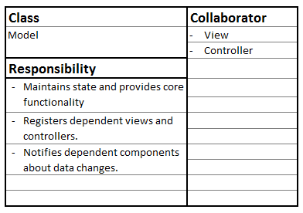
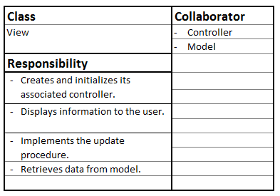
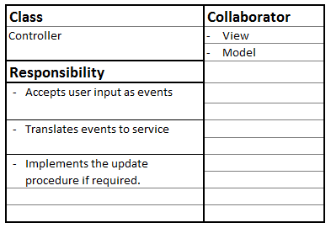
MVC
MVC - Context

Slide 16
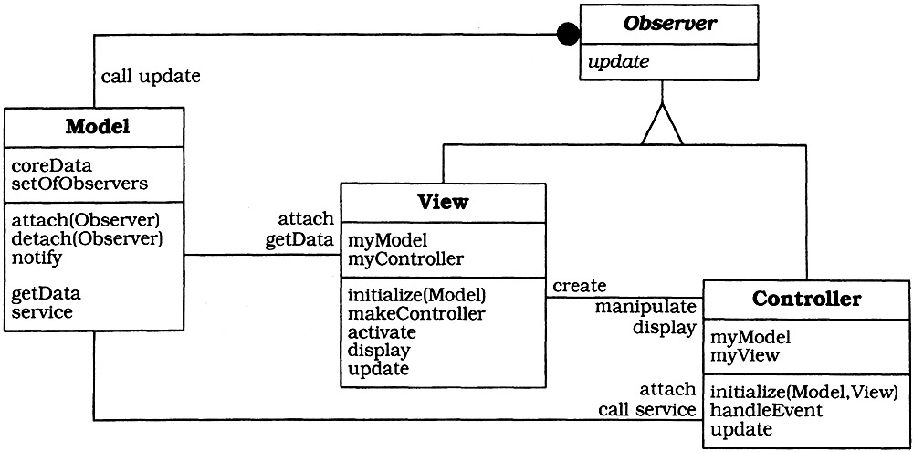
MVC
MVC Architecture
Notes:
Recommend looking at charts on slide 15 and seeing how they correlate.

Slide 17
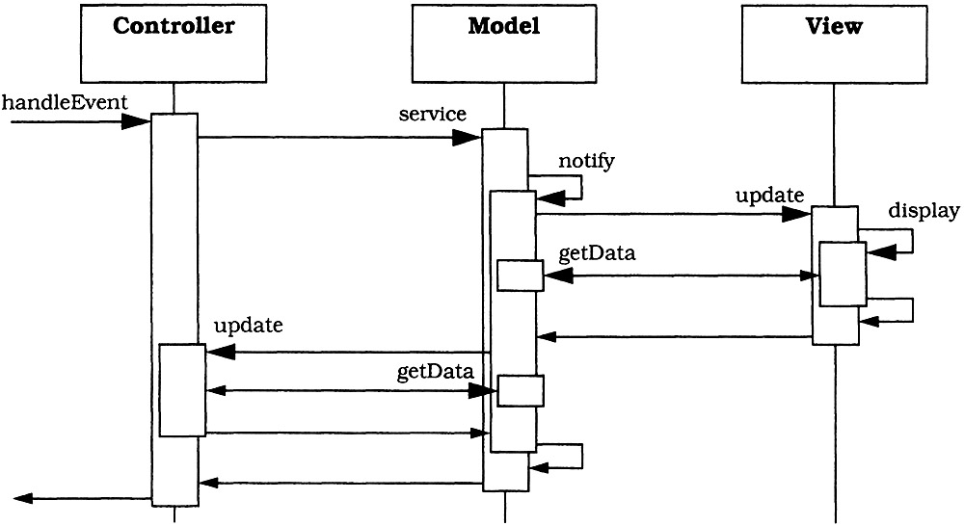
MVC
MVC - Usage Scenario
Notes:
sequence diagram that illustrates interactions between the Controller, Model, and View components in a system that follows the Model-View-Controller (MVC) design pattern.
You may need to design both for complexity of component distribution in a heterogeneous computer network and also for adaptability of their user interfaces.
The BROKER pattern provides the infrastructure for the distribution of components, while the model in the MVC pattern plays the role of a server in the BROKER infrastructure.
Controllers take roles of clients, and views combine the roles of clients and servers, as clients of the model and servers of the controllers.
Recommend looking at charts on slide 15 and seeing how they correlate. Next few slides explain this.

Slide 18
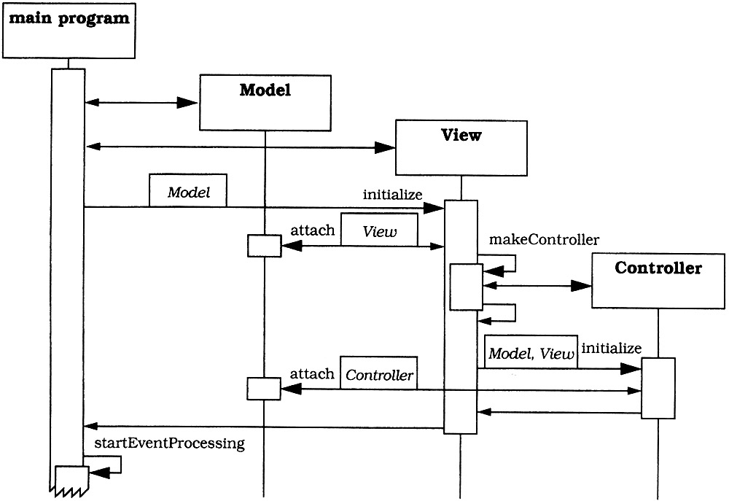
MVC
MVC - Initialization
Notes:
sequence diagram showing the initialization process of a system using the Model-View-Controller (MVC) architecture
Main idea is that the human-computer interaction is separated from the core functionality.
Recommend looking at charts on slide 15 and seeing how they correlate. Next few slides explain this.

Slide 19
MVC
MVC - Implementation
Separate human-computer interaction from the core functionality.
Design the model to encapsulate the data and functionality needed for the core.
Provide functions for accessing the data to be displayed.
Decide which parts of the model's functionality are to be exposed to the user via the controller, and add a corresponding interface to the model.

Slide 20
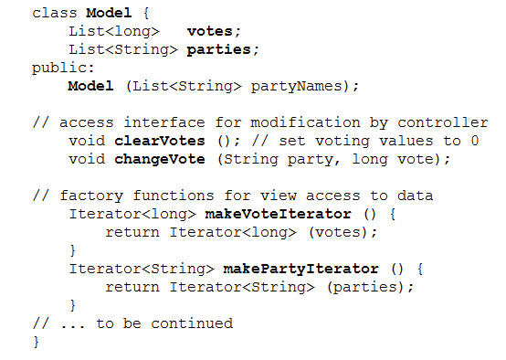
MVC
MVC - Implementation
Stores the names of political parties and the number of votes in two lists.
Provides iterators to each list.

Slide 21
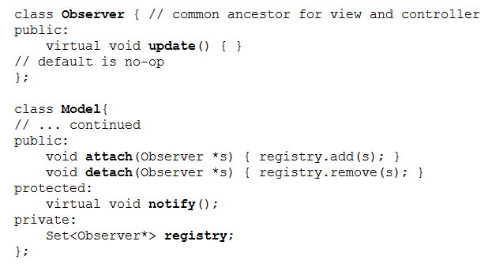
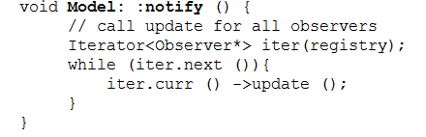
MVC
MVC - Implementation
Implement change-propagation mechanism. Assign role of publisher to the model.
The methods changeVote() and clearVotes() call notify() after the voting data is changed.

Slide 22
MVC
MVC - Implementation
Design and implement views
Design the appearance of each view, and also
Specify and implement a draw procedure to display the view on the screen (which acquires data from model).
Design and implement the controllers.
For each view, specify the behavior of the system in response to user actions (treated as an event).
A controller receives and interprets these events using a dedicated procedure (in non-trivial cases, this can depend on the state of the model).

Slide 23
MVC
MVC - Implementation
Design and implement the view-controller relationship.
A view typically creates its associated controller during its initialization.
When you build a class hierarchy of views and controllers, apply the Factory Method design pattern and define a method makeController() in the view classes.
Notes:
"Define an interface for creating an object, but let subclasses decide which class to instantiate. The Factory method lets a class defer instantiation it uses to subclasses." (Design Patterns: Elements of Reusable Object-Oriented Software (1994))

Slide 24
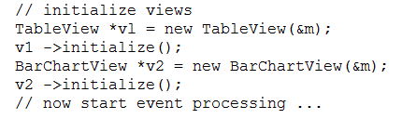
MVC
MVC - Implementation
Implement the set-up of MVC.
The set-up code first initializes the model, then creates and initializes the views.
After initialization, event processing is started.
Because the model should remain independent of specific views and controllers, this set-up code should be placed externally, for example, in a main program.

Slide 25
MVC
MVC - Issues
Increased complexity.
Potential for excessive number of updates.
Close coupling between the view and controller models → M (VC).
Inefficient data access from the view.
Modifications are needed to port to alternate platforms (unless this was designed into the original architectural solution).
Notes:
Reminder: coupling is the probability that a modification to one module will propagate to the other.

Slide 26
Patterns
Pattern: MVVM
The Model-View-ViewModel (MVVM) architectural pattern also divides the application into three components.

Slide 27
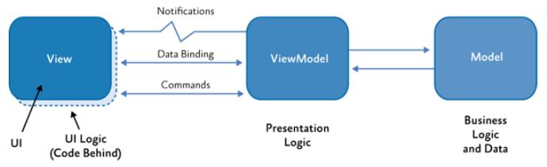
MVVM
MVVM: Model-View-ViewModel
Separate the UI of the application and the underlying presentation and business logic into three separate classes:
view, which encapsulates the UI and UI logic;
view model, which encapsulates presentation logic and state;
model, which encapsulates the application's business logic and data.

Slide 28
MVVM
MVVM: Model-View-ViewModel
View: Defines the structure and appearance of what the user sees on the screen. Ideally, the code behind a view contains only a constructor that calls the InitializeComponent method.
View Model: Encapsulates presentation logic and data for the view. It has no direct reference to the view and implements properties and commands to which the view can data-bind. It notifies the view of any state changes through notification events.
Model: Encapsulates business logic and data, i.e. application logic concerned with the retrieval and management of application data and for ensuring business rules are imposed.

Slide 29
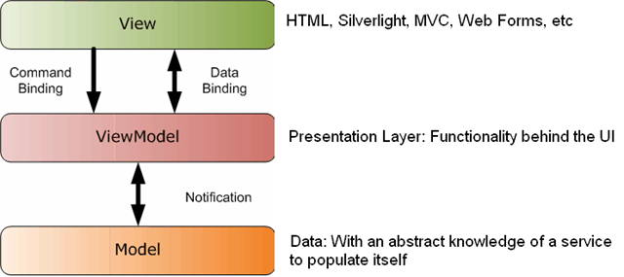
MVVM
public MainPage() { InitializeComponent(); // create a model object
_event = new EventModel() { Date = new DateTime(2011, 7, 1),
Title = "Silverlight User Group" }; // bind the Date to the UI
EventDate.SetBinding(DatePicker.SelectedDateProperty,
new Binding("Date") { Source = _event, Mode = BindingMode.TwoWay }); // bind the Title to the UI
EventTitle.SetBinding(TextBox.TextProperty, new Binding("Title") { Source = _event, Mode = BindingMode.TwoWay }); }
<Grid> ... <TextBlock Text="Name:" Grid.Row="1" /> <TextBox x:Name="EventTitle" Grid.Row="1" Grid.Column="1"/>
<TextBlock Text="Date:" Grid.Row="2"/> <sdk:DatePicker x:Name="EventDate" Grid.Row="2" Grid.Column="1"/> </Grid>
Notes:
////
Which part is this?
ViewModel Layer: The SetBinding code and the two-way binding are parts of the ViewModel responsibilities because they handle the synchronization between the Model and the View.
The ViewModel in MVVM exposes properties (like Date and Title) and handles binding logic to keep the View in sync with the Model.
The _event object (even though it is the Model itself here) is managed through bindings, which is typically handled by the ViewModel.
View Layer: The DatePicker and TextBox are UI elements (from the View layer) bound to the data exposed by the ViewModel. They visually represent the Model data and allow for interaction.

Slide 30
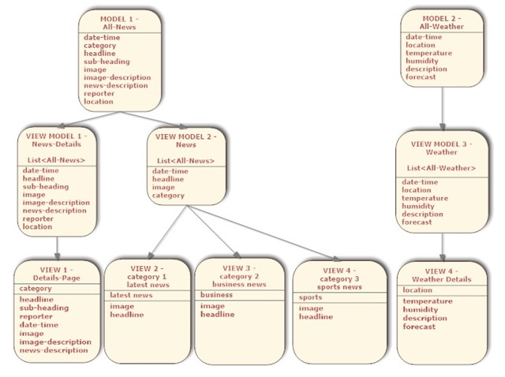
MVVM
MVVM pattern for a news reader application

Slide 31
Patterns
Other Patterns

Slide 32
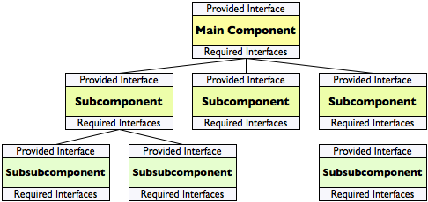
Other Styles
Hierarchical Style
The interface of the system is provided by a single component (the Main Component above). Some components implement their interfaces with the help of subcomponents; no subcomponent contributes to more than a single parent component. The connectors are typically function or method calls.
http://www.thomasalspaugh.org/pub/fnd/architecture.html

Slide 33
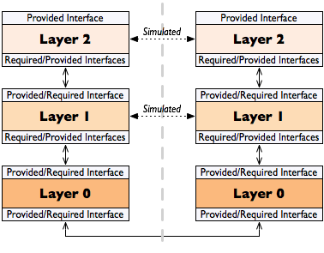
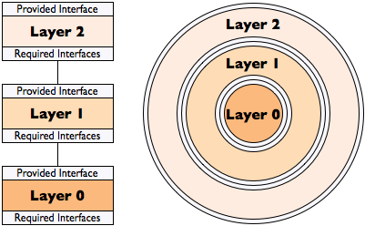
Other Styles
Layers and Protocol Stacks
Two stacks simulate communication at each level, although in fact communication only occurs between the lowest levels, the Layer 0s. Each Layer 2 provides an interface for communicating with the other stack through its Layer 2 interface. It appears to the user of Layer 2 that the communication is occurring at that level. However, communication is really passed down to the next layer.
http://www.thomasalspaugh.org/pub/fnd/architecture.html

Slide 34
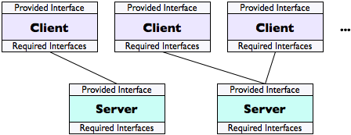
Other Styles
Client-Server
The server provides an interface so that clients connect as needed to request the service provided by the server.
The set of clients is often variable and connections are commonly made only as needed. Several servers may provide the same services, in which case a client may connect to any, and may look up a server in some kind of directory in order to locate an appropriate one; clients may be directed to whichever server is least busy, in order to balance the load and provide the fastest service.
http://www.thomasalspaugh.org/pub/fnd/architecture.html

Slide 35
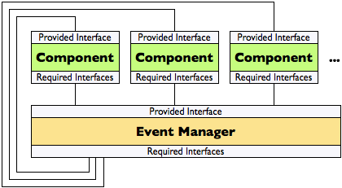
Other Styles
Event-Based Invocation
Components register their interest in specific events with an event manager (using its provided interface), making a callback method on its provided interface available to the event manager as one of its required interfaces.
When a registered event is detected by the event manager, it calls the callback method of every component registered for it and gives each one the event.
http://www.thomasalspaugh.org/pub/fnd/architecture.html

Slide 36

Other Styles
Pipe and Filter
A pipe-and-filter architecture utilizes components that are filters: they take a sequence of inputs and produce a sequence of processed outputs from it. The outputs of each filter become the inputs of the next filter in the pipeline. The system may rearrange the filters in the pipeline at run time, substituting, adding, or deleting filters to achieve different results.
Often used in image, audio, or other signal processing. Unix command line scripts often incorporate chains of commands (filters), such as grep PAT|sort|uniq for extracting lines matching PAT, sorting them, and discarding repetitions.

